Slide 1


Slide 2
Agenda
Client needs
Why API-led connectivity?
API-led conectivity benefits
Mulesoft approach
Application Demo
Q/A

Slide 3



Solving Client Needs
You have this
Your answer
You need this

Slide 4



Why API-led connectivity?
Unified connectivity
Lowest friction
Future proof
Connect to anything
SOA, SaaS and APIs on one platform
Highly productive
Designed for ease of use and deployability
Ready for hybrid IT
Write once, deploy anywhere

Slide 5

API-led connectivity: An approach to unlocking your organization
App Dev
Experience APIs
(purpose-built APIs for apps)
LoB Dev/IT
Process APIs
(orchestration, composable APIs, Microservices)
Central IT
System APIs
(legacy modernization, connectivity to SaaS apps, web services & Restful APIs)
Accessibility
& Ownership
SaaS apps
Mainframe
FTP, Files
Databases
Web services
Legacy Systems
Applications

Slide 6



Applications don’t have to be monolithic

Slide 7
Enable composability with APIs

Slide 8
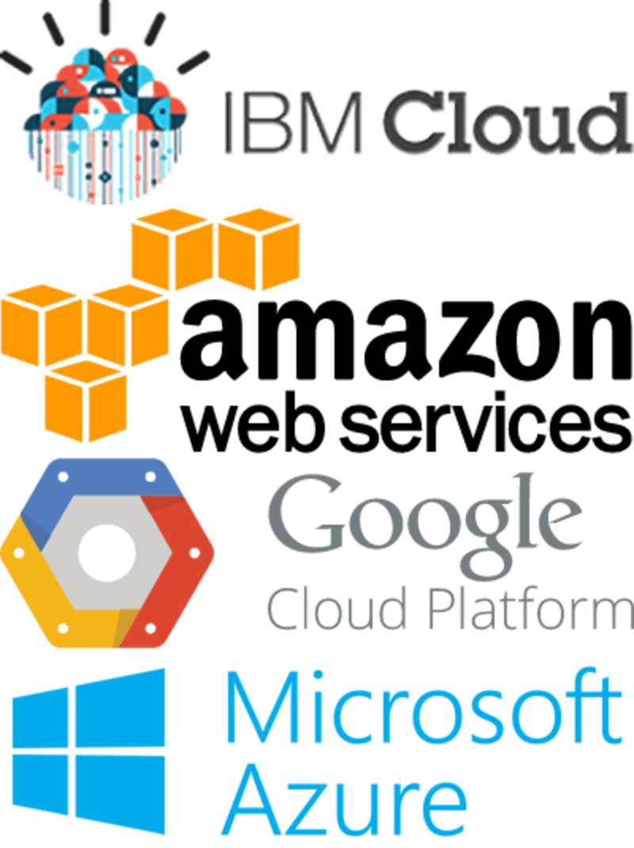






Hybrid solutions with MuleSoft
Cloud
Social
SaaS
Customers, partners suppliers
Databases
Customer Apps

Slide 9
The Anypoint Platform from MuleSoft

Slide 10
How it works?

Slide 11
Questions and Answers time!
?

